Slide 1

CSE 350 Digital Electronics and Pulse Techniques
Digital to Analog Converter (ADC)
Course Instructor: Shomen Kundu (SDU)
Mail: shomen.kundu@bracu.ac.bd
Desk: 4N148

Slide 2
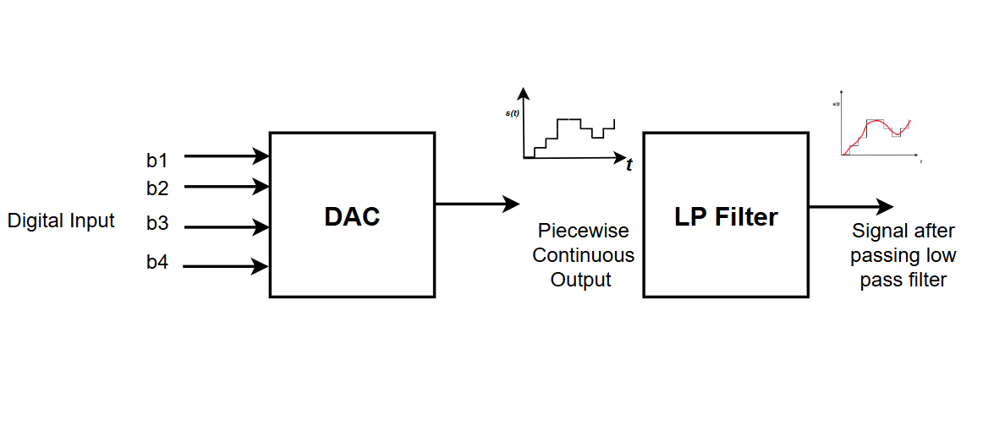
Digital to Analog Converter (DAC)

Slide 3
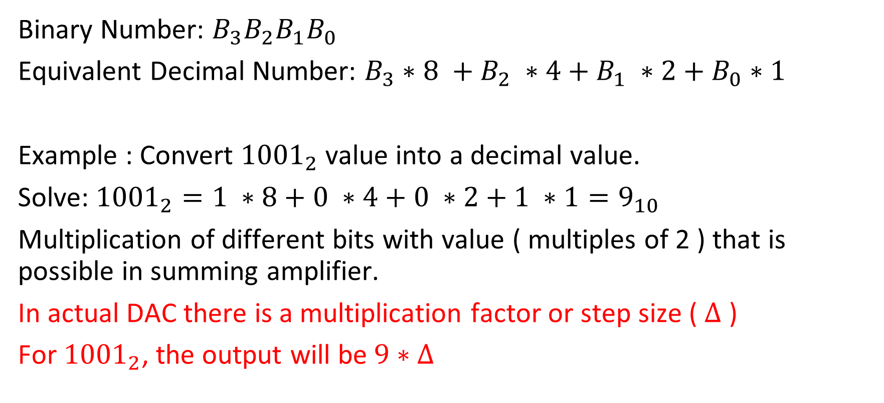
Technique of DAC ( Binary to Decimal Conversion )
Binary Number: ${B_{3}B_{2}B_{1}B}_{0}$
Equivalent Decimal Number: $B_{3}∗8 +B_{2} ∗4+B_{1} ∗2+B_{0}∗1$
Example : Convert ${1001}_{2}$value into a decimal value.
Solve: ${1001}_{2}=1 ∗8+0 ∗4+0 ∗2+1 ∗1=9_{10}$
Multiplication of different bits with value ( multiples of 2 ) that is possible in summing amplifier.
In actual DAC there is a multiplication factor or step size ( $∆$ )
For ${1001}_{2}$, the output will be $9∗∆$

Slide 4
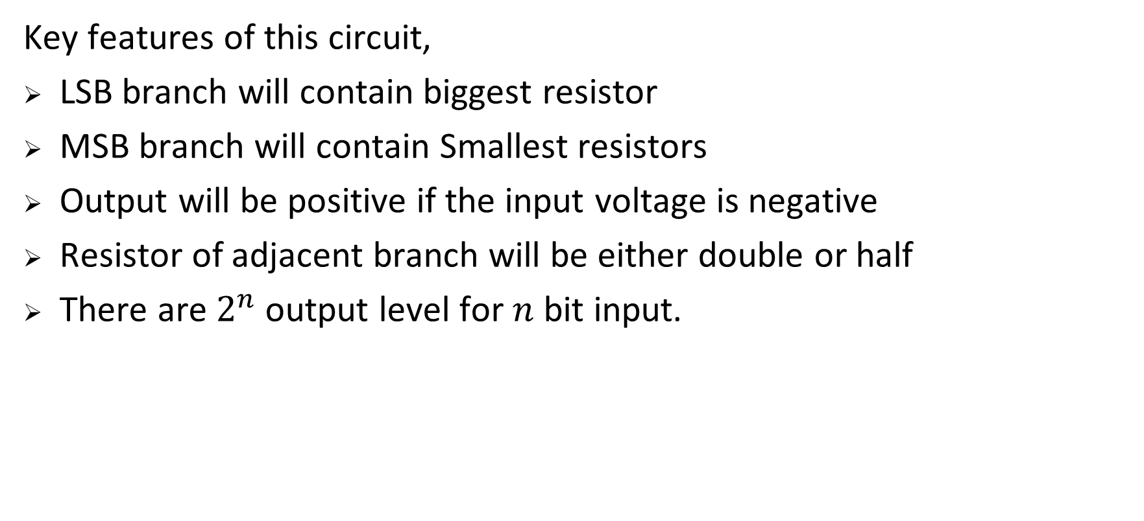
Binary Weighted DAC
Key features of this circuit,
LSB branch will contain biggest resistor
MSB branch will contain Smallest resistors
Output will be positive if the input voltage is negative
Resistor of adjacent branch will be either double or half
There are $2^{n}$output level for $n$ bit input.

Slide 5
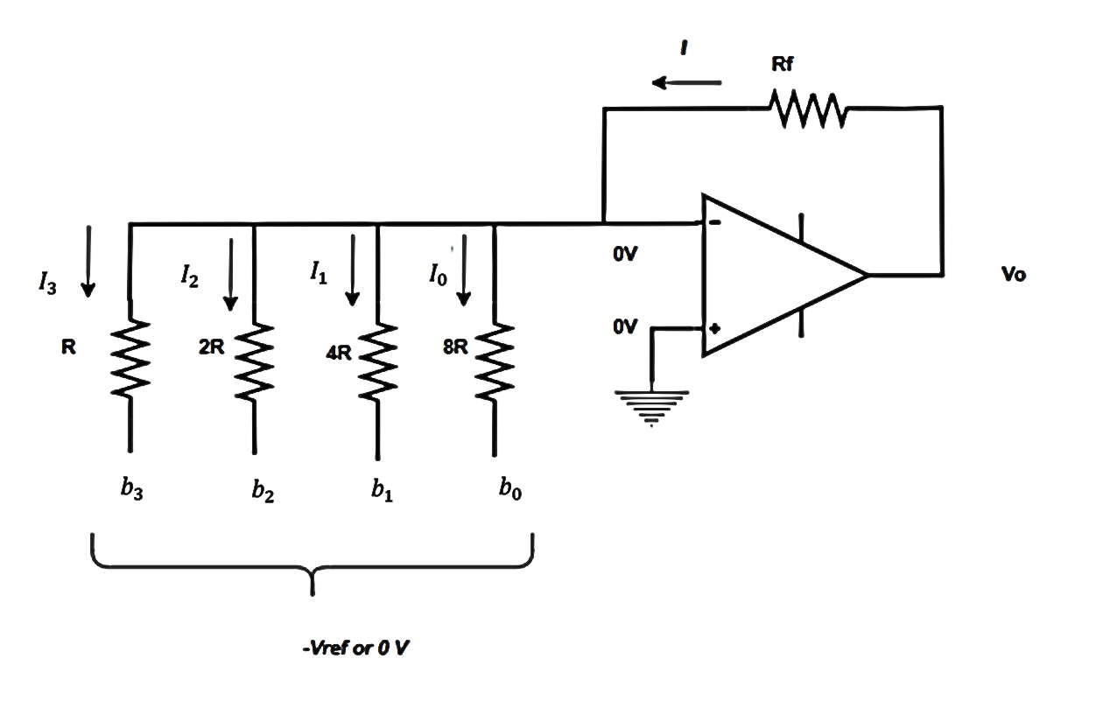
Output of the DAC circuit

Slide 6
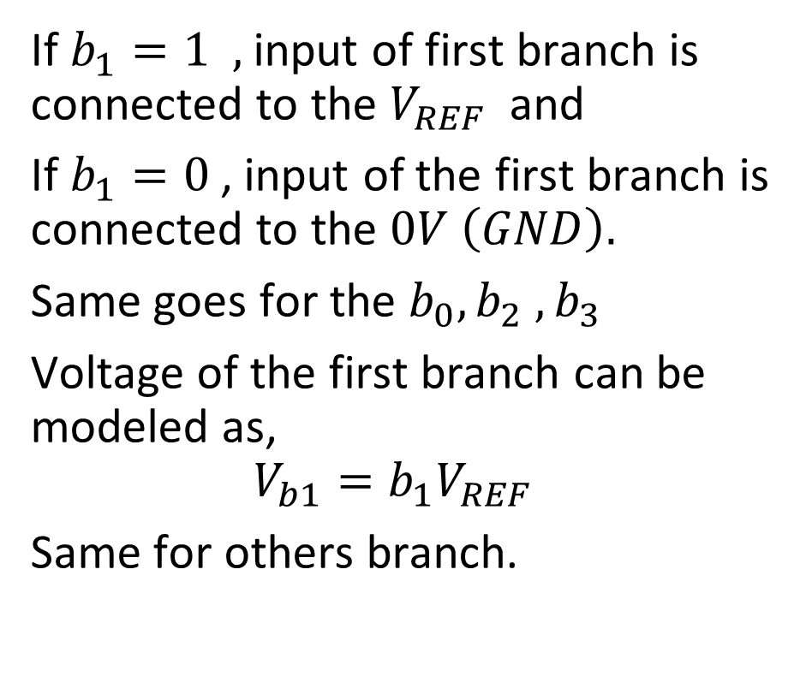
Digital to Analog Converter (DAC)
If $b_{1}=1 ,$ input of first branch is connected to the $V_{REF}$ and
If $b_{1}=0$, input of the first branch is connected to the $0V \left(GND\right).$
Same goes for the $b_{0}, b_{2} , b_{3}$
Voltage of the first branch can be modeled as,
$$V_{b1}=b_{1}V_{REF}$$
Same for others branch.

Slide 7

Digital to Analog Converter (DAC)
Node equation at $V_{−}$ terminal,
$$I=I_{3}+I_{2}+I_{1}+I_{0}$$
$$⇒\frac{V_{o}−0}{R_{F}}=\frac{0−({b_{3}V}_{REF})}{R}+\frac{0−({b_{2}V}_{REF})}{2R}+\frac{0−(b_{1}V_{REF})}{4R}+\frac{0−(b_{0}V_{REF})}{8R}$$
$V_{o} ={−V}_{REF}( b_{3}+\frac{b_{2}}{2}+\frac{b_{1}}{4}+\frac{b_{0}}{8} )$ ($R_{f}=R)$

Slide 8

Digital to Analog Converter (DAC)
Table: For different input combination. Combination $=2^{4} =16 , V_{REF}=−8 V$, $R_{F}=R$

Slide 9
B2 | B2 | B1 | B0 | Vo
0 | 0 | 0 | 0 | 0V
0 | 0 | 0 | 1 | 1V
0 | 0 | 1 | 0 | 2V
0 | 0 | 1 | 1 | 3V
0 | 1 | 0 | 0 | 4V
0 | 1 | 0 | 1 | 5V
0 | 1 | 1 | 0 | 6V
0 | 1 | 1 | 1 | 7V
1 | 0 | 0 | 0 | 8V
1 | 0 | 0 | 1 | 9V
1 | 0 | 1 | 0 | 10V
1 | 0 | 1 | 1 | 11V
1 | 1 | 0 | 0 | 12V
1 | 1 | 0 | 1 | 13V
1 | 1 | 1 | 0 | 14V
1 | 1 | 1 | 1 | 15V

Slide 10
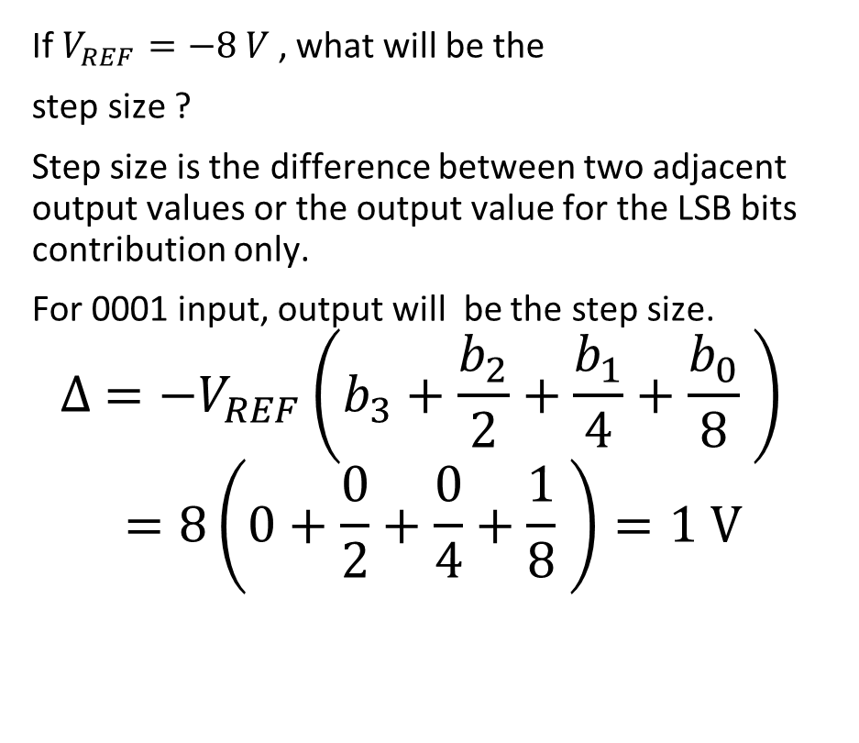
Step Size
If $V_{REF}=−8 V$, what will be the
step size ?
Step size is the difference between two adjacent output values or the output value for the LSB bits contribution only.
For 0001 input, output will be the step size.
$$∆ ={−V}_{REF}\left(b_{3}+\frac{b_{2}}{2}+\frac{b_{1}}{4}+\frac{b_{0}}{8} \right)$$
$$=8\left(0+\frac{0}{2}+\frac{0}{4}+\frac{1}{8} \right)=1 V$$

Slide 11
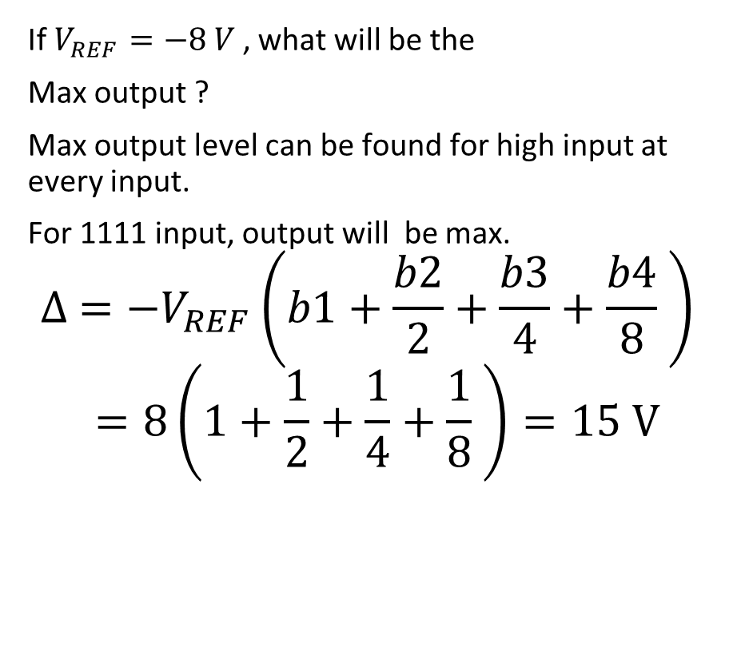
Maximum Output
If $V_{REF}=−8 V$, what will be the
Max output ?
Max output level can be found for high input at every input.
For 1111 input, output will be max.
$$∆ ={−V}_{REF}\left(b1+\frac{b2}{2}+\frac{b3}{4}+\frac{b4}{8} \right)$$
$$=8\left(1+\frac{1}{2}+\frac{1}{4}+\frac{1}{8} \right)=15 V$$

Slide 12
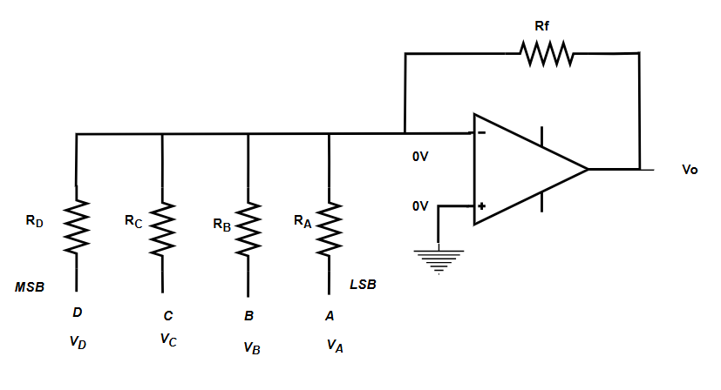
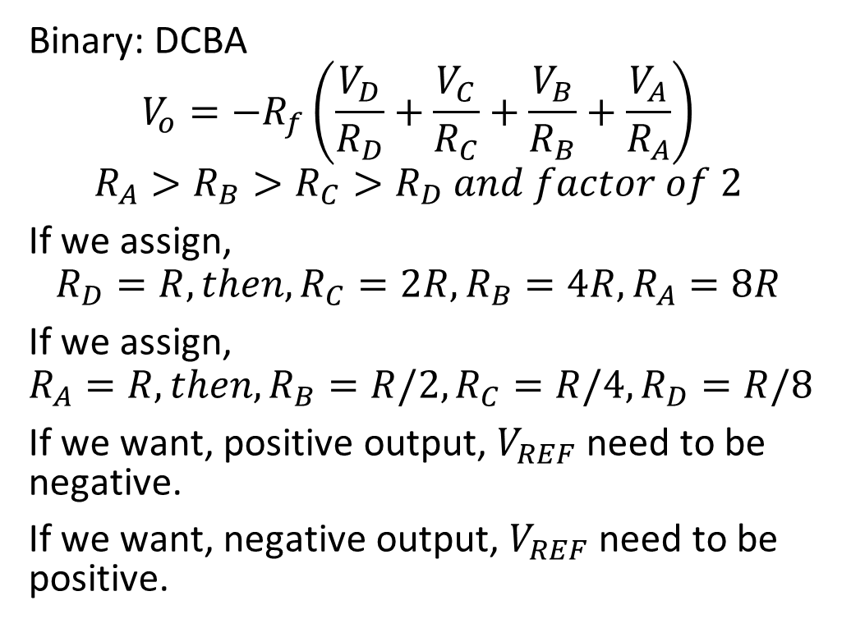
General Formula for DAC
Binary: DCBA
$$V_{o}=−R_{f}\left(\frac{V_{D}}{R_{D}}+\frac{V_{C}}{R_{C}}+\frac{V_{B}}{R_{B}}+\frac{V_{A}}{R_{A}}\right)$$
$$R_{A}>R_{B}>R_{C}>R_{D} and factor of 2$$
If we assign,
$$R_{D}=R, then, R_{C}=2R, R_{B}=4R, R_{A}=8R$$
If we assign,
$$R_{A}=R, then, R_{B}=R/2, R_{C}=R/4, R_{D}=R/8$$
If we want, positive output, $V_{REF}$need to be negative.
If we want, negative output, $V_{REF}$need to be positive.

Slide 13
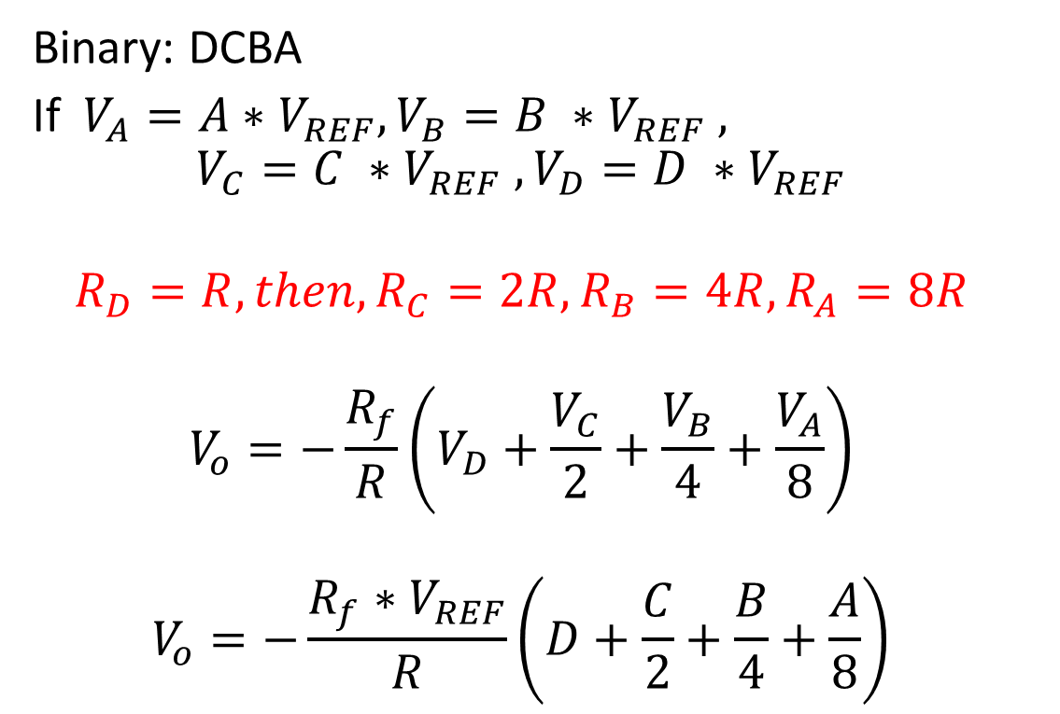
DAC (MSB→ R)
Binary: DCBA
If $V_{A}=A∗V_{REF}, V_{B}=B ∗V_{REF} ,$
$$V_{C}=C ∗V_{REF} , V_{D}=D ∗V_{REF}$$
$$R_{D}=R, then, R_{C}=2R, R_{B}=4R, R_{A}=8R$$
$$V_{o}=−\frac{R_{f}}{R}\left(V_{D}+\frac{V_{C}}{2}+\frac{V_{B}}{4}+\frac{V_{A}}{8}\right)$$
$$V_{o}=−\frac{R_{f}∗V_{REF}}{R}\left(D+\frac{C}{2}+\frac{B}{4}+\frac{A}{8}\right)$$

Slide 14
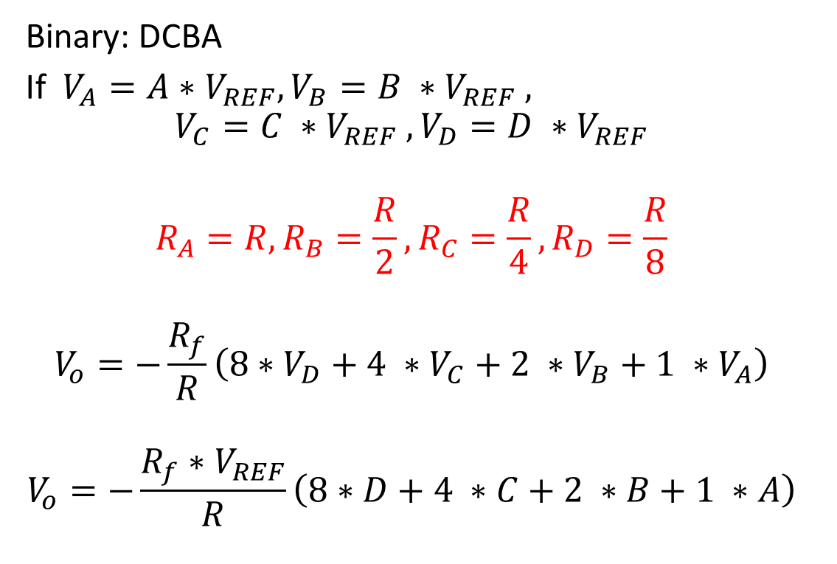
DAC (LSB → R)
Binary: DCBA
If $V_{A}=A∗V_{REF}, V_{B}=B ∗V_{REF} ,$
$$V_{C}=C ∗V_{REF} , V_{D}=D ∗V_{REF}$$
$$R_{A}=R,R_{B}=\frac{R}{2},R_{C}=\frac{R}{4},R_{D}=\frac{R}{8}$$
$$V_{o}=−\frac{R_{f}}{R}\left(8∗V_{D}+4 ∗V_{C}+2 ∗V_{B}+1 ∗V_{A}\right)$$
$$V_{o}=−\frac{R_{f}∗V_{REF}}{R}\left(8∗D+4 ∗C+2 ∗B+1 ∗A\right)$$

Slide 15
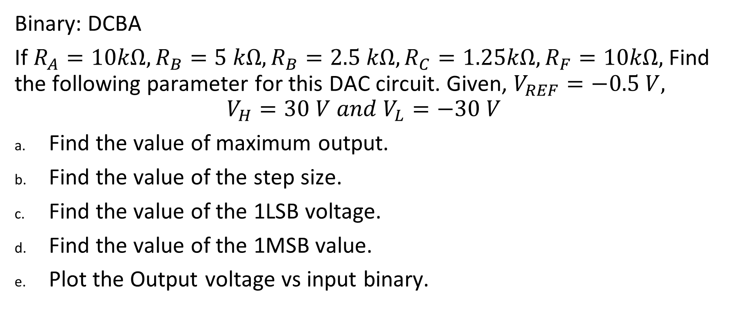
Exercise:
Binary: DCBA
If $R_{A}=10kΩ,R_{B}=5 kΩ,R_{B}=2.5 kΩ,R_{C}=1.25kΩ,R_{F}=10kΩ,$Find the following parameter for this DAC circuit. Given, $V_{REF}=−0.5 V,$
$$V_{H}=30 V and V_{L}=−30 V$$
Find the value of maximum output.
Find the value of the step size.
Find the value of the 1LSB voltage.
Find the value of the 1MSB value.
Plot the Output voltage vs input binary.

Slide 16
Exercise:
Design a 4 bits binary weighted DAC circuit with reference voltage of -5 V and step size of 0.5 V.

Slide 17
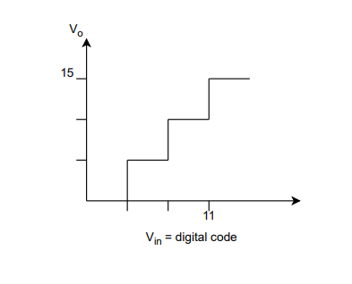

Exercise:
The figure below shows the input-output characteristics of a converter. The output of the converter is denoted as $V_{0}$ and the input as $V_{in}$. Identify the converter type and the number of bits used by the converter. Further, calculate $V_{ref}$ when LSB resistance = R and$R_{F} = 2R$.

Slide 18
R2R Ladder
Disadvantage of Binary Weighted DAC: A lot of different resistors are used. Fluctuations in their values can cause errors in output voltage. New techniques 2 different resistors R and 2R.

Slide 19
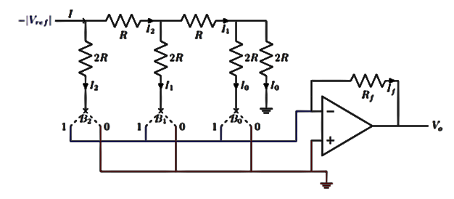
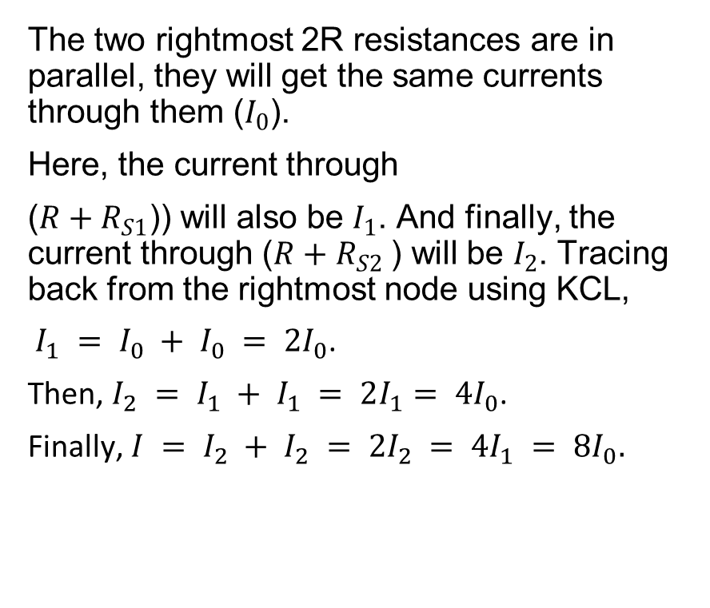
R2R Ladder Circuit (Upper Vref )
The two rightmost 2R resistances are in parallel, they will get the same currents through them ($I_{0}$).
Here, the current through
($R+R_{S1}$)) will also be $I_{1}$. And finally, the current through ($R+R_{S2}$) will be $I_{2}$. Tracing back from the rightmost node using KCL,
$I_{1} = I_{0} + I_{0} = 2I_{0}$.
Then, $I_{2} = I_{1} + I_{1} = 2I_{1}= 4I_{0}$.
Finally, $I = I_{2} + I_{2} = 2I_{2} = 4I_{1} = 8I_{0}.$

Slide 20

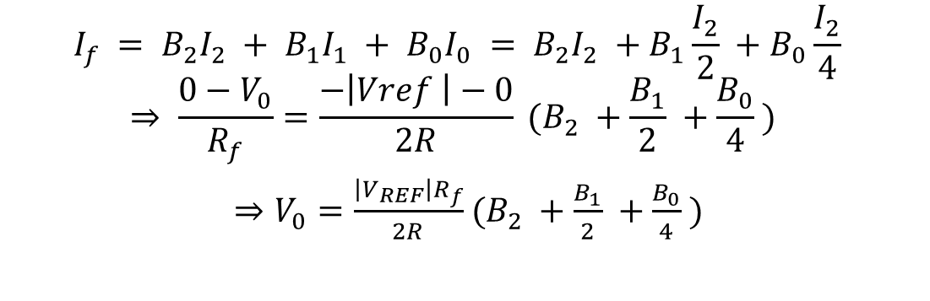
R2R Ladder Circuit (Upper Vref )
LSB is close to OPAMP MSB is close to $V_{REF}$
$$I_{f} = {B_{2}I}_{2} + {B_{1}I}_{1} + {B_{0}I}_{0} = {B_{2}I}_{2} +B_{1}\frac{I_{2}}{2} +B_{0}\frac{I_{2}}{4}$$
$$⇒ \frac{0−V_{0}}{R_{f}}=\frac{−\left|Vref \right|−0}{2R} (B_{2} +\frac{B_{1}}{2} +\frac{B_{0}}{4} )$$
$⇒V_{0}=\frac{\left|V_{REF}\right|R_{f}}{2R}$ $(B_{2} +\frac{B_{1}}{2} +\frac{B_{0}}{4} )$

Slide 21
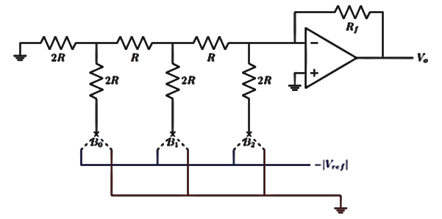

R2R ladder Circuit ( Lower Vref )
$⇒V_{0}=\frac{\left|V_{REF}\right|R_{f}}{2R}$ $(B_{2} +\frac{B_{1}}{2} +\frac{B_{0}}{4} )$
MSB is close to OPAMP

Slide 22
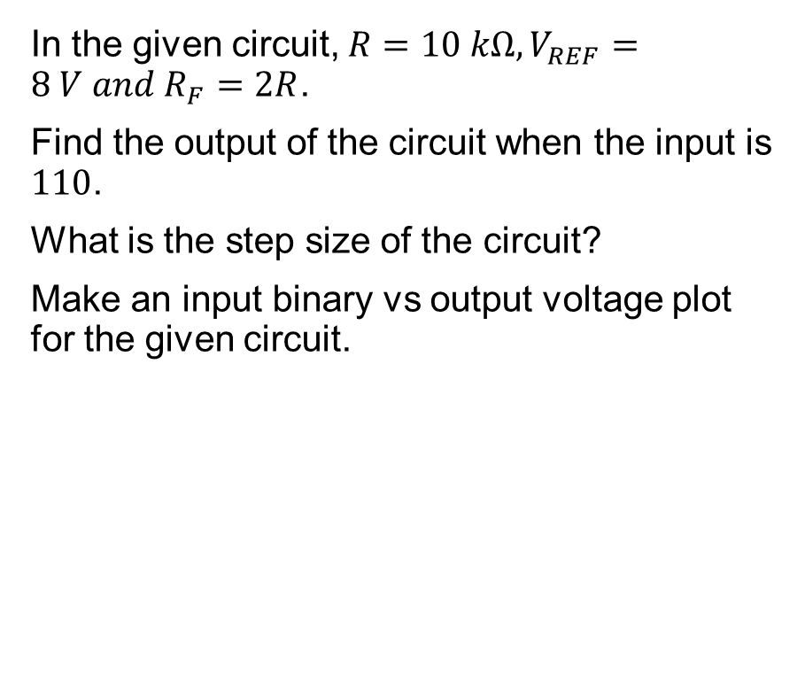
Exercise
In the given circuit, $R=10 kΩ, V_{REF}=8 V and R_{F}=2R$.
Find the output of the circuit when the input is $110$.
What is the step size of the circuit?
Make an input binary vs output voltage plot for the given circuit.

